Slide 1
Data Science Capstone
By: Tyler Halterman

Slide 2
Introduction
Group Indianapolis Police Beats by crime data and housing costs
Use the k-cluster unsupervised machine learning methodology to cluster neighborhoods according to similar venues
Use Four Square's API to retrieve venue data within a 500m range
Use deductive reasoning to determine the best beat to live in within budget that is also safe

Slide 3
Data
I used the following Data Sets Obtained from:
Police Crime Map Data
IMPD Crime Base Dataset
Realtor House Values by Beat
Zillow, Best Places, Realtor
Venue Data
Four Square’s API
Latitude/Longitude
Google Maps

Slide 4
Methodology
The general Flow of the Project Consisted of the following Steps:
1. Import Libraries
2. Import Data Sets
3. Perform Data Cleaning and Convert to Data Frames
4. Plot Crime, Housing, and Beat Data
5. Retrieve Lat/Long Data from Google
6. Use Four Square’s API to Retrieve Venue Data
7. K-Clustering Unsupervised Machine Learning Algorithm to Analyze Beats

Slide 5
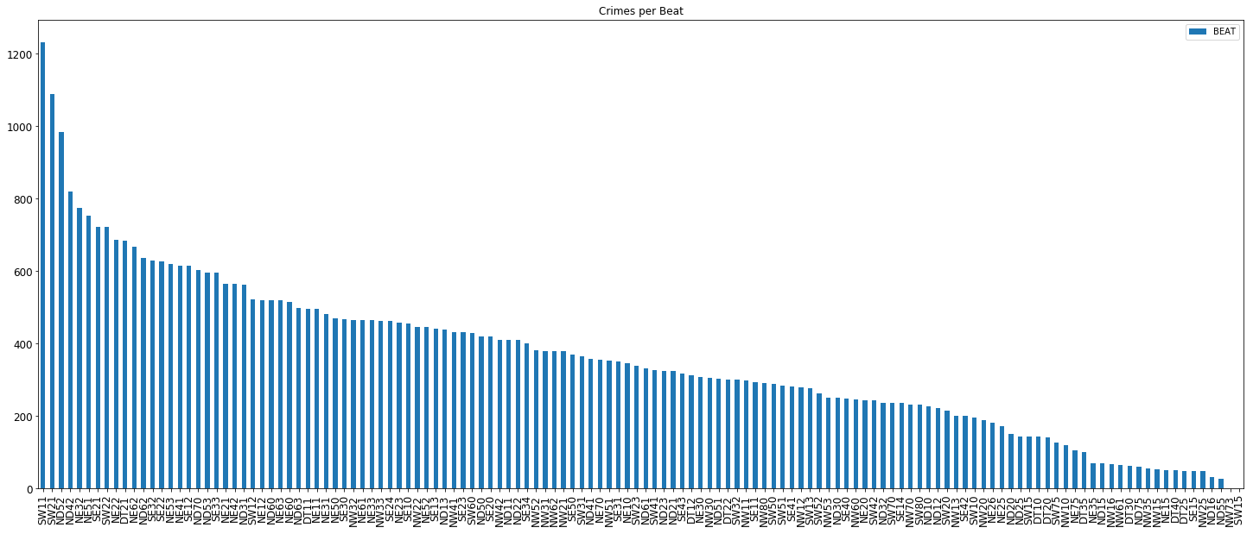
Results: Crimes per Beat

Slide 6
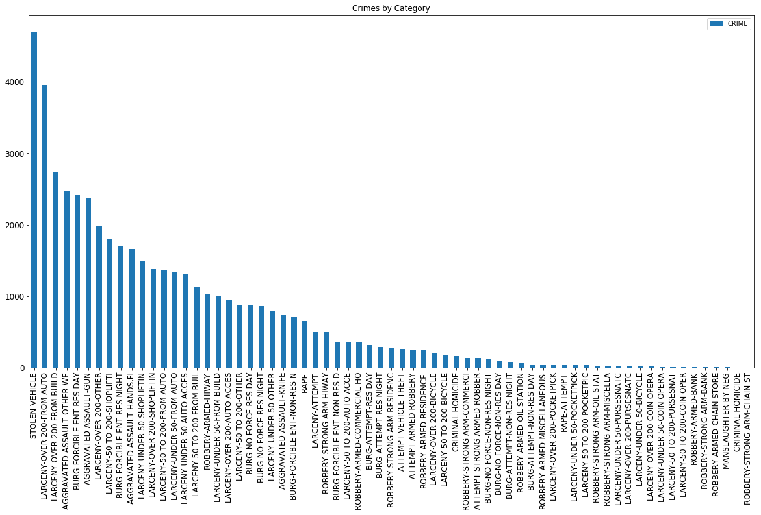
Results: Crimes by Category

Slide 7
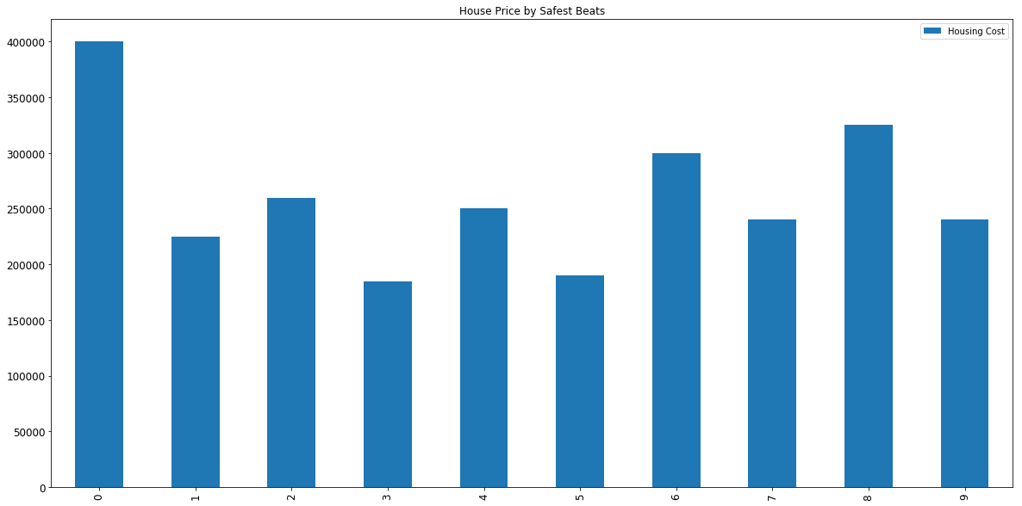
Results: Housing Costs by Beat

Slide 8
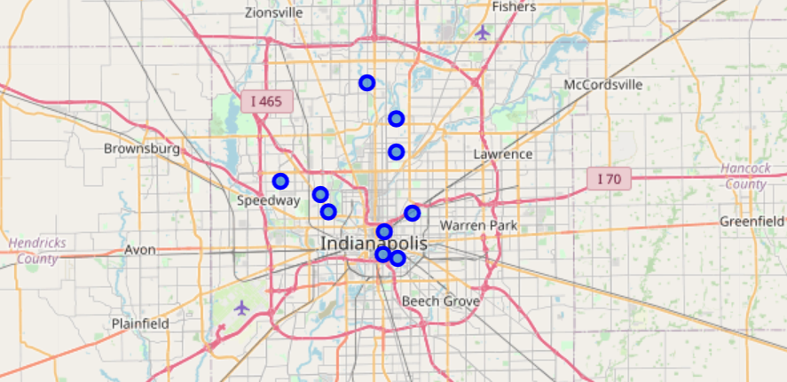
Results: Beat Locations

Slide 9
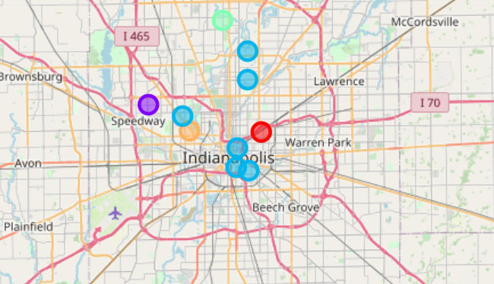
Results: Beat Locations by Cluster

Slide 10
Overall Results
My overall results for this project were as follows:
1. For the widest array of venues in an affordable housing market you would want to live in cluster 2 which composes most of downtown.
2. As a second option living by the INDY 500 track provides more shopping alternatives than cluster 2 but is also a bit more expensive.
3. Although the beats with higher crime rates do reside in cluster 2, it is worth noting that housing prices are far more affordable and there is a lot more to do overall.
4. The further one gets out into the country, a sharp decrease in venue selection is accompanied by rising housing costs due to the influence of suburbia.

Slide 11
Conclusions
I have learnt quite a bit from this course. As this was my first time taking any sort of real Data
Science course, I feel I will walk away with a greater toolset than I started. This will no doubt
help me in my career. Thanks for a great course!

